Slide 1
Use Version Control
Github repositories
Everyone working from the same set of files
No emails with big files attached
If you use a common system, workflows are much easier to navigate!
You can have private & public repos
Github is GDPR compliant!
Notes:
TO DO
Find out the R experts & make sure they are present!
Make sure everything installed – Github desktop, R , Rstudio
Follow links that Elaine sent to connect (step 3 on desktop)
Make sure people open Github_demo.proj
Install packages too!

Slide 2
Getting started with GitHub
Make sure your Rstudio is linked with R and both are up-to-date
Create a GitHub account https://docs.github.com
Install GitHub Desktop
https://docs.github.com/en/desktop/installing-and-authenticating-to-github-desktop/installing-github-desktop
Link GitHub Desktop to your Github Account

Slide 3
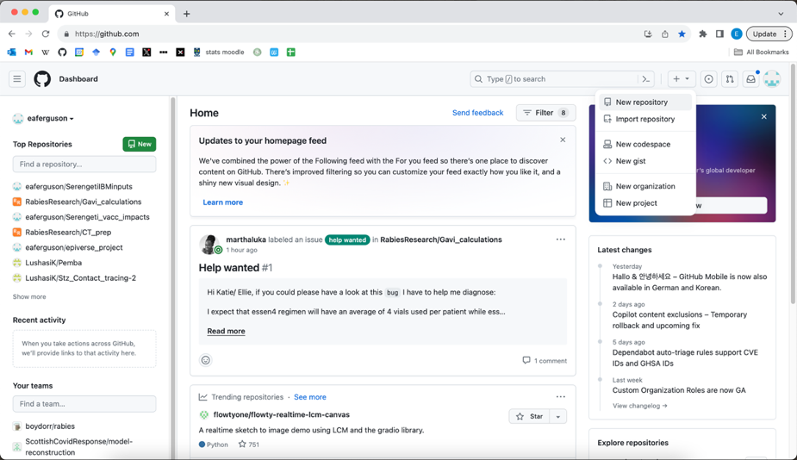
Creating a repository

Slide 4
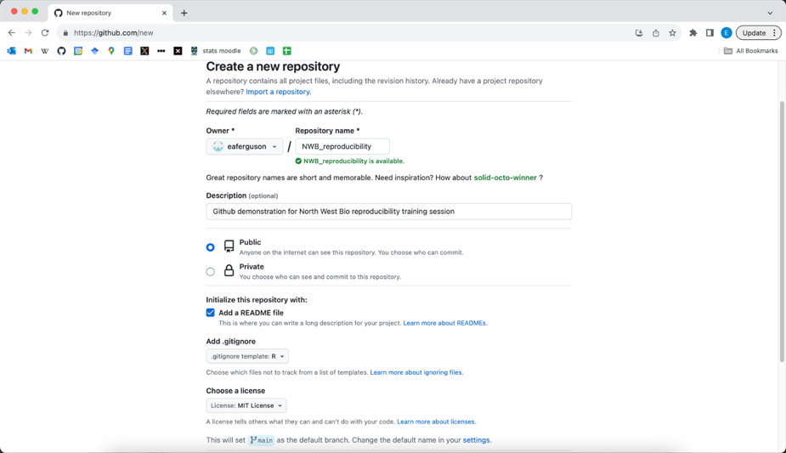
Creating a repository

Slide 5
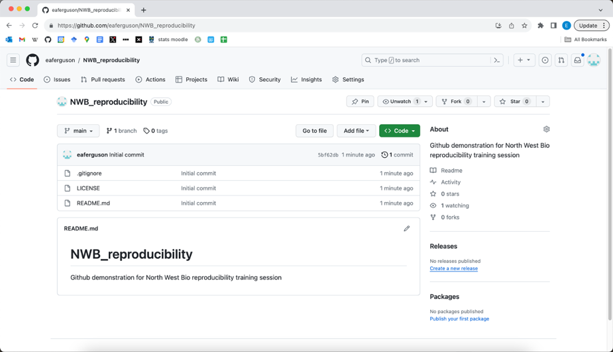
Creating a repository

Slide 6
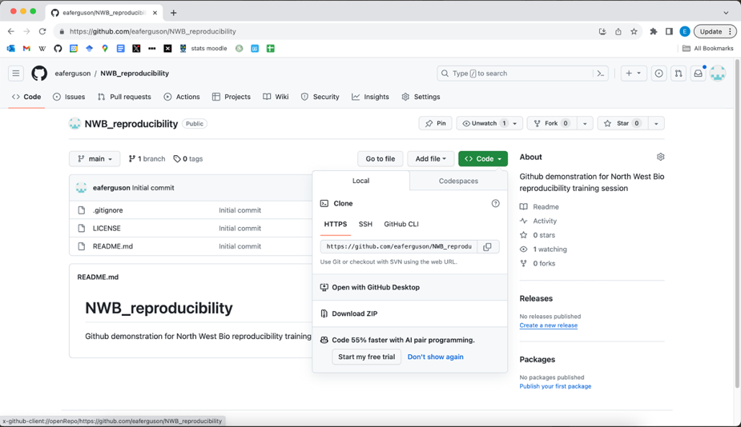
Clone repository using GitHub desktop

Slide 7
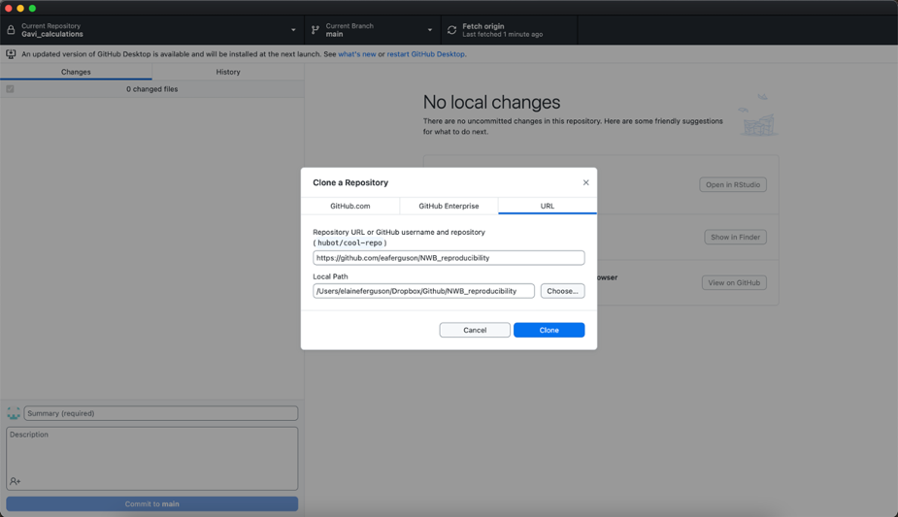
Clone repository using GitHub desktop
Repo URL
Local folder

Slide 8
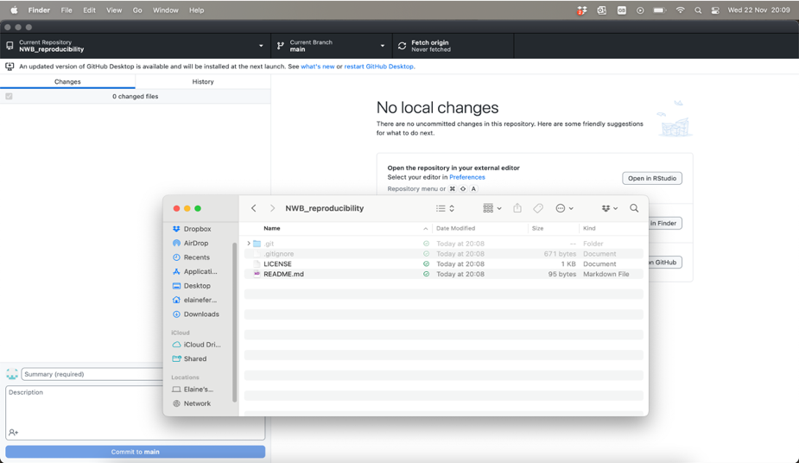
Clone repository using GitHub desktop

Slide 9
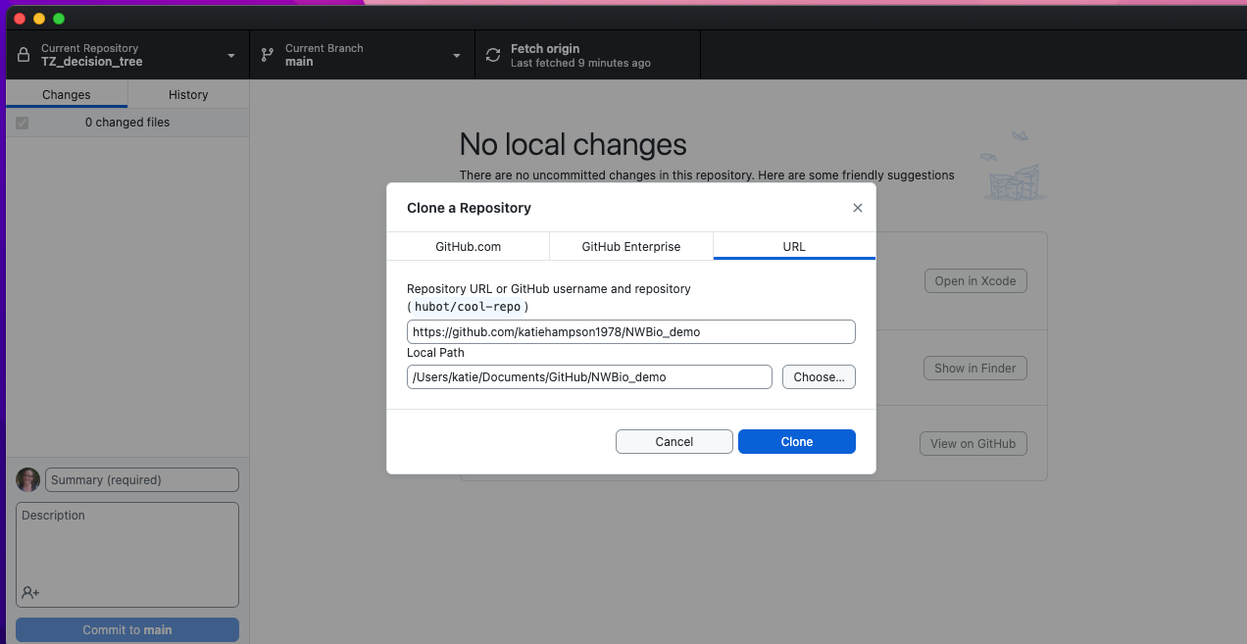
Now try to clone my repo!
URL: https://github.com/katiehampson1978/NWBio_demo

Slide 10
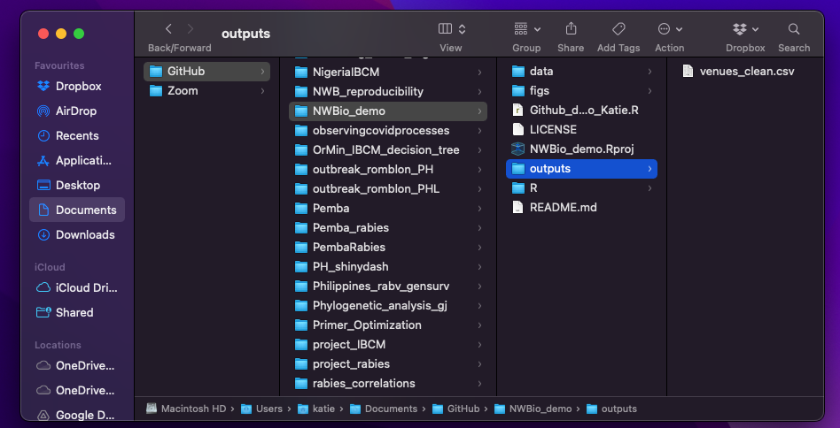
The saved code and outputs

Slide 11
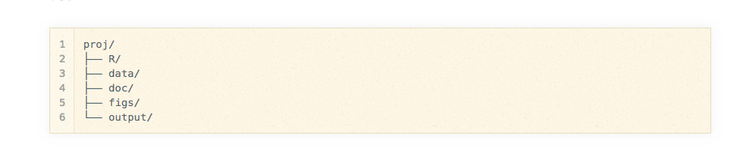
Note there is a system to help work effectively:
Keep raw data in data folder. Do not edit!
Archive older data (& code) just in case

Slide 12
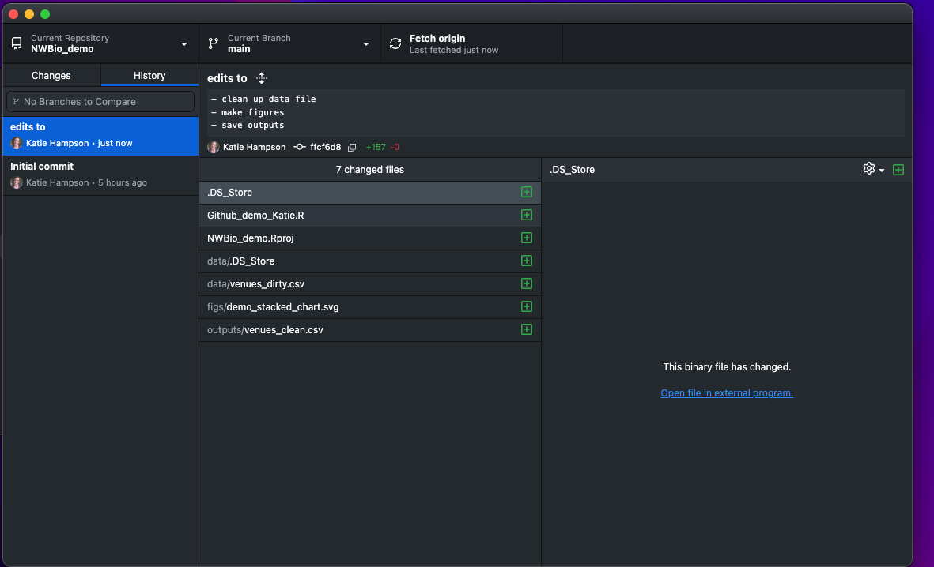
Updated via Github

Slide 13
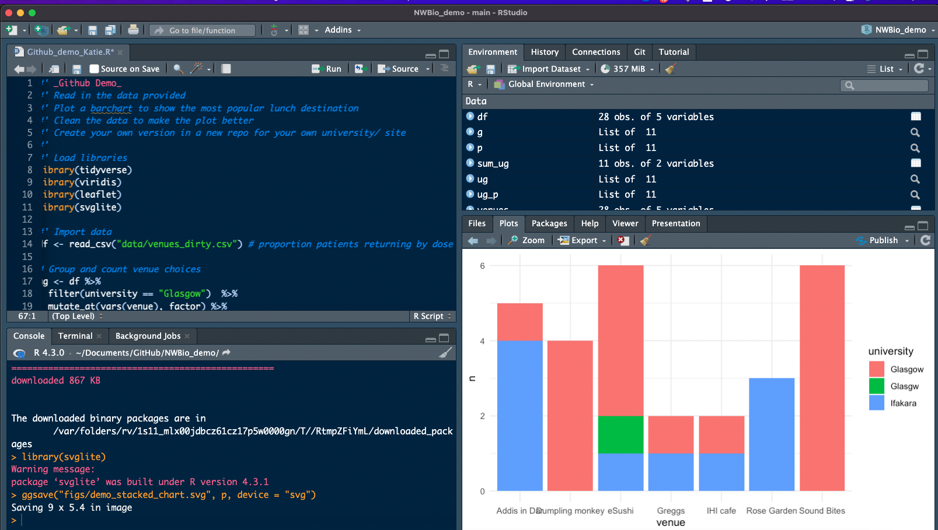
The code
Double click on NWBio_demo.Rproj to open the project in Rstudio
Go to the files pane (bottom right) and open Github_demo_Katie.R

Slide 14
Also note some basic good practice (project management)
Provide a README!
Use a clear folder structure
Create an Rproj
Save outputs e.g. saveRDS
Use informative file & folder names
Separate raw data from processed data

Slide 15
Can you run the code?
What does each code section do?
What is saved and where?
What needs fixing?

Slide 16
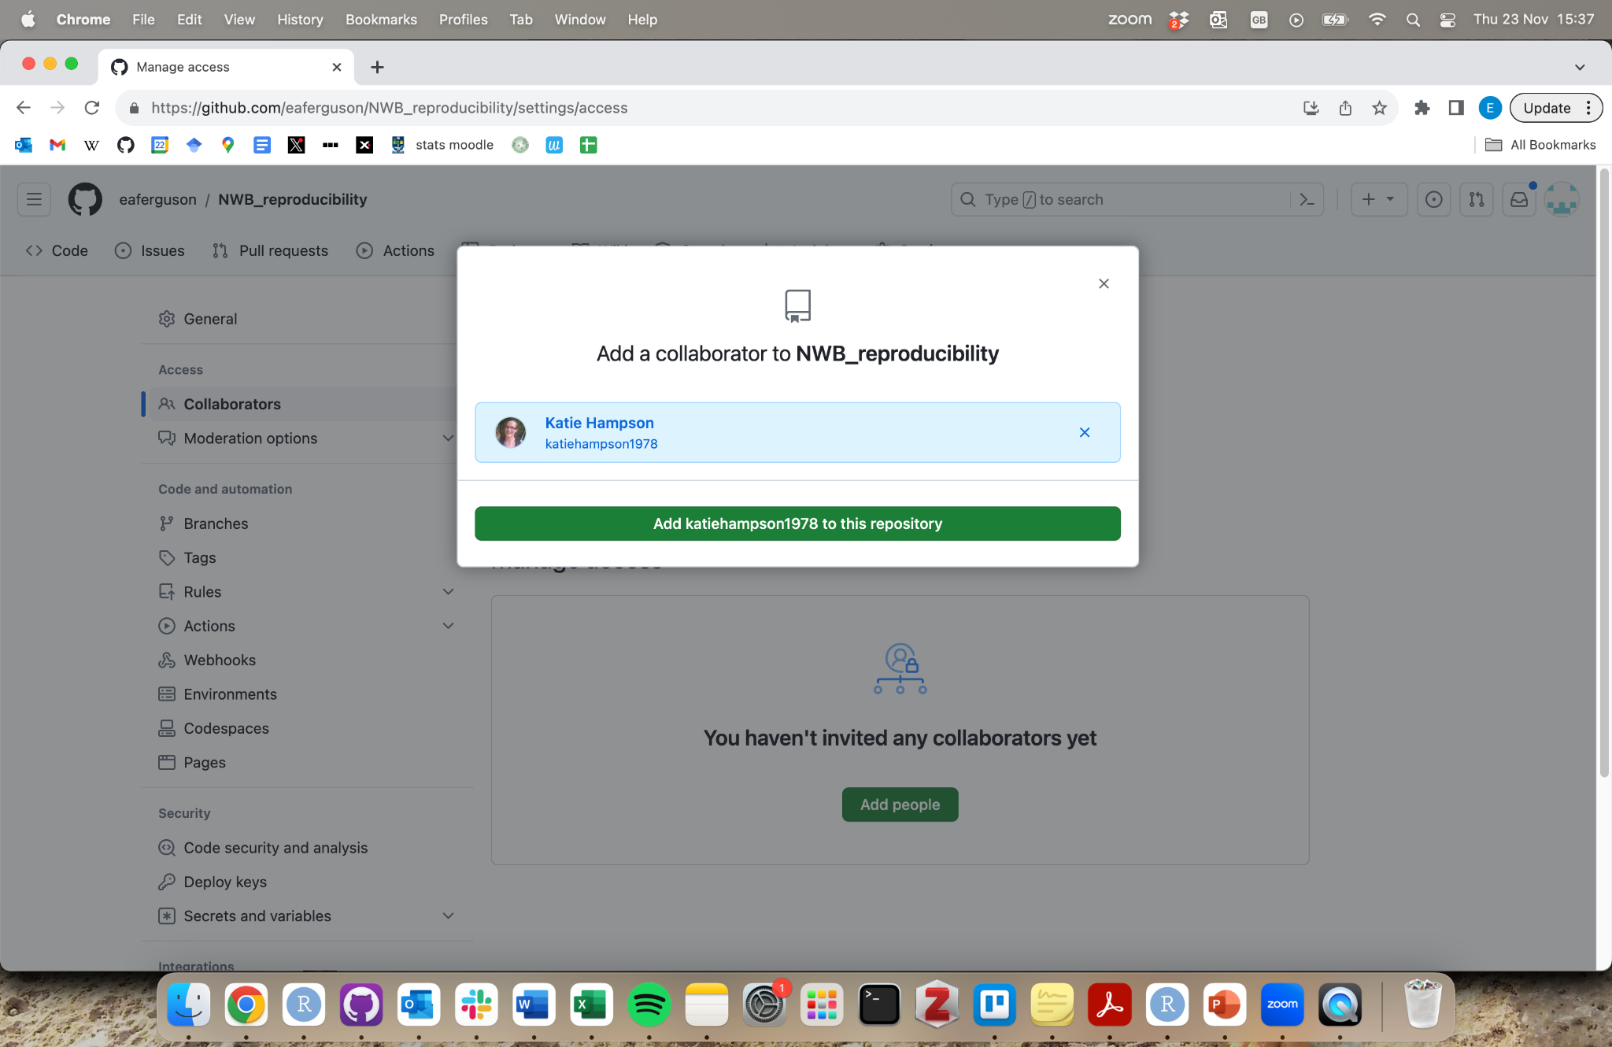
Add collaborators
To allow others to make changes to your repo, navigate to: Settings/Collaborators

Slide 17
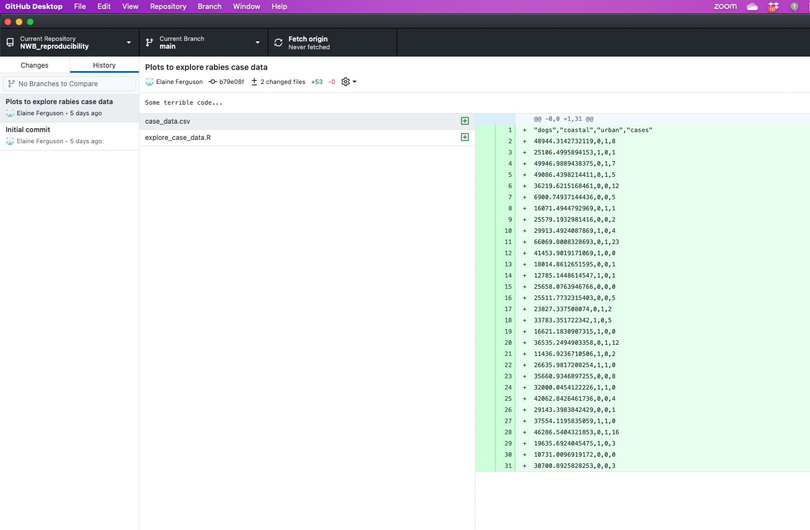
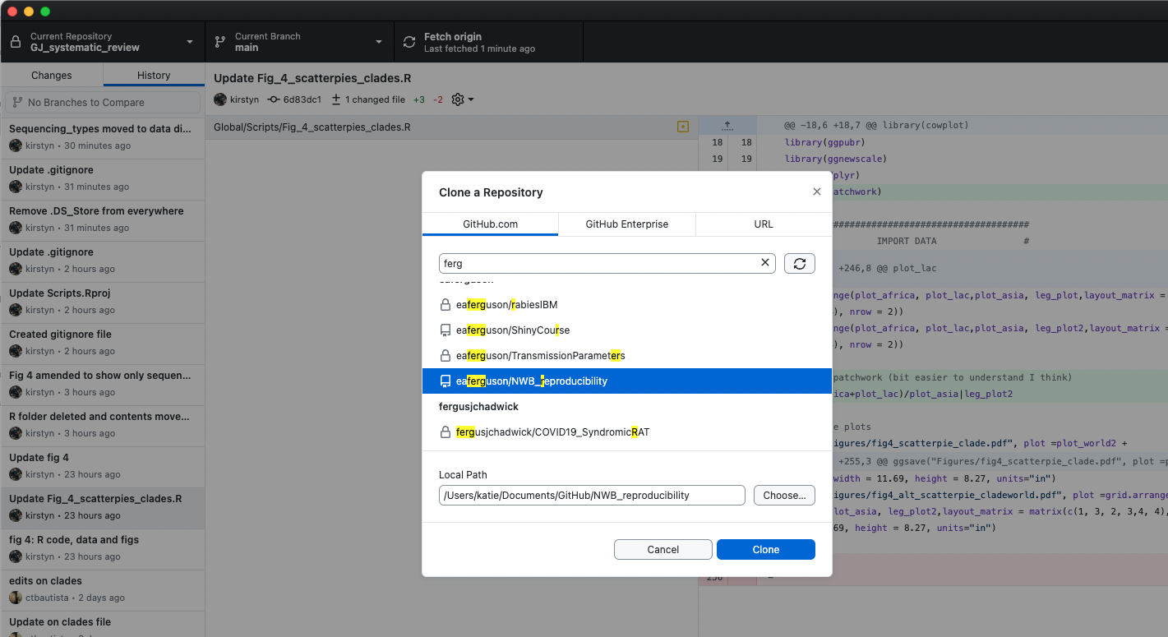
Collaborator accepted invite & cloned repo

Slide 18
Create your own repo
In groups:
Create a new Github repo for creating and analysing your own voting data using one group member’s account.
Invite all other group members to be collaborators
All clone your new repo

Slide 19
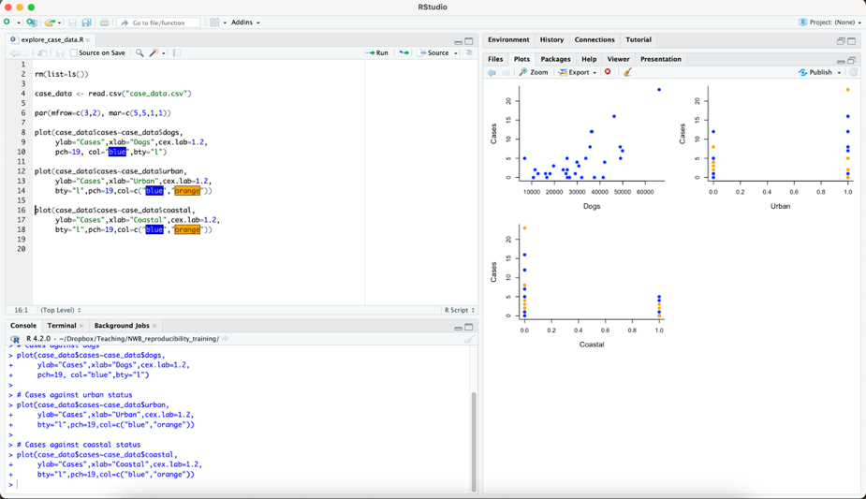
Adding to your repo
Here, Elaine is adding some data and code to create some simple plots

Slide 20
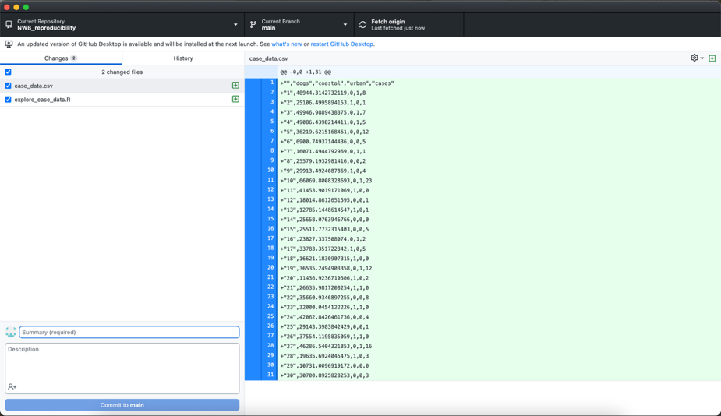
Changes to your local repo are visible in GitHub Desktop

Slide 21
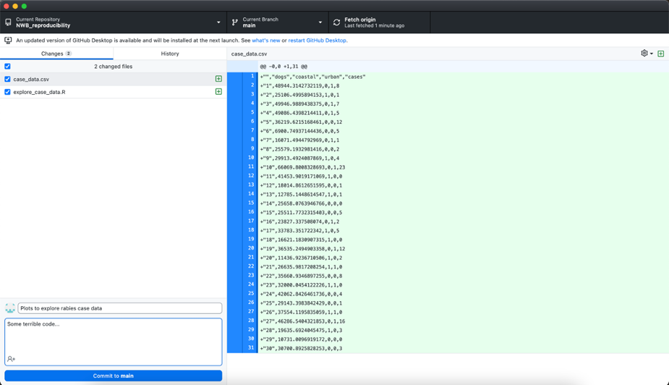
Commit the changes locally

Slide 22
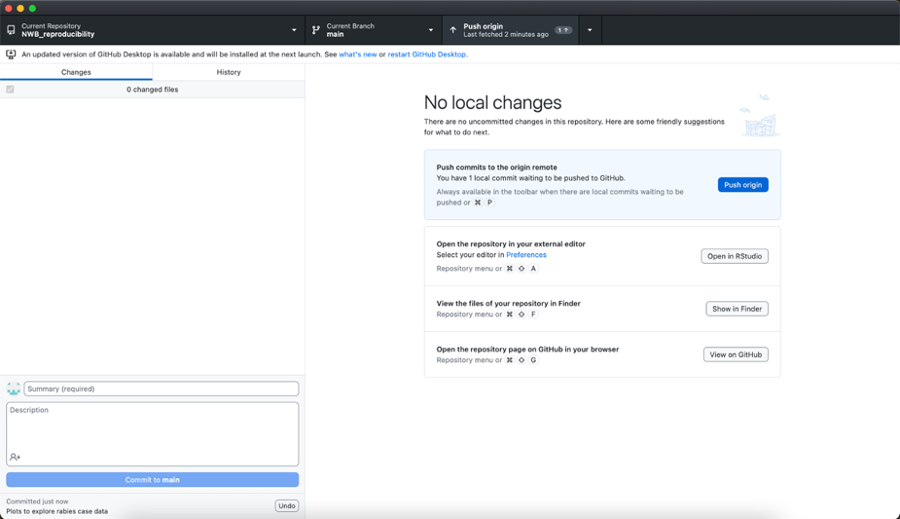
Push the changes to GitHub

Slide 23
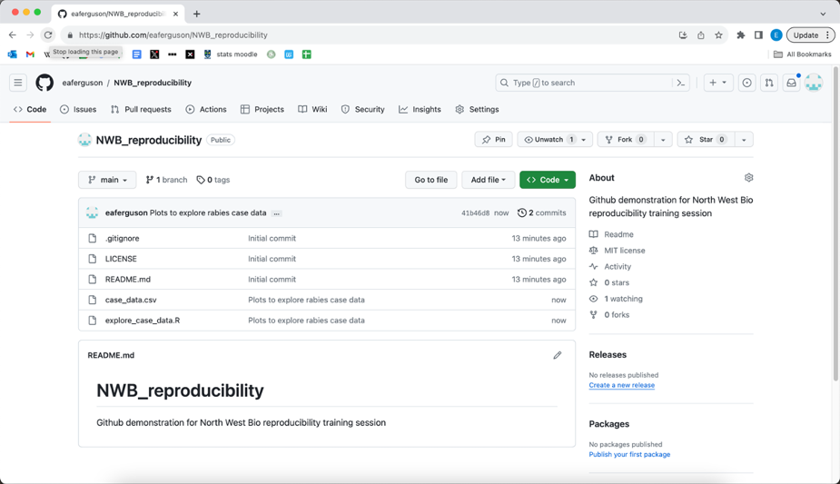
Push the changes to GitHub

Slide 24
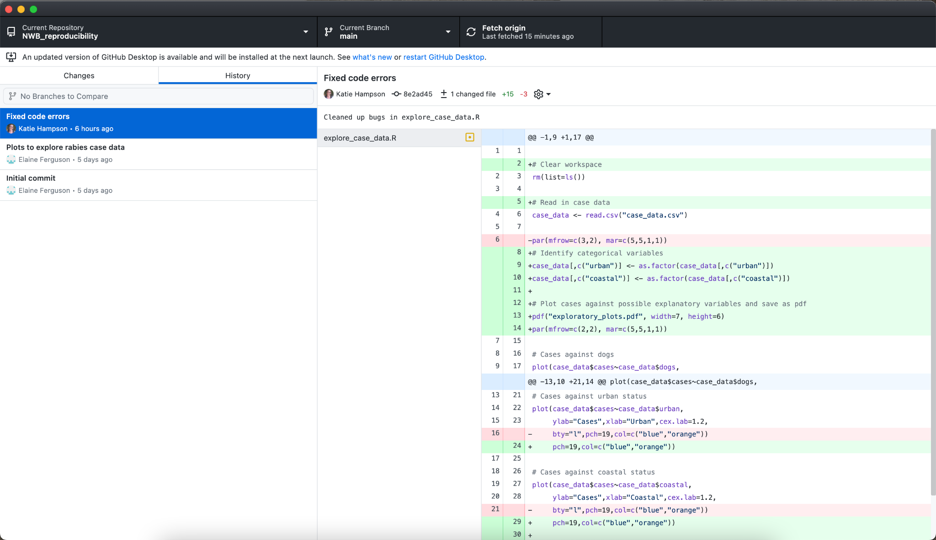
Collaborators fetch and pull changes from GitHub
Now everyone has a copy of the most recent files downloaded from Github to their local repo

Slide 25
Adding data to your repository in collaboration with your group
Have one group member create a spreadsheet with ~5 rows of made-up voting data, similar to the example repo you cloned earlier. Save locally (in a folder named “data”), commit, and push to GitHub.
Another group member should fetch and pull the new data file, open it in excel and add some more rows of data, save, and push back to GitHub
Repeat 2. until everyone has had a go at adding and pushing some data. Don’t be tempted to have multiple people editing the file at the same time!!
Make sure everyone pulls the final version of the data

Slide 26
Explore your new data using R
Work together in your groups to create a new R project (open a new RStudio window, and look in the top right corner) and develop an R script based on the one in the example repo that:
Reads in your data
Creates a barplot of votes for each option
Saves the barplot as a .svg file
Don’t worry if not everything looks perfect immediately – you’ll fix it up later!
Commit and push the script from whoever’s local repo it is saved in to GitHub
Everyone else fetch and pull from GitHub, and try and run the script in RStudio on your machine

Slide 27
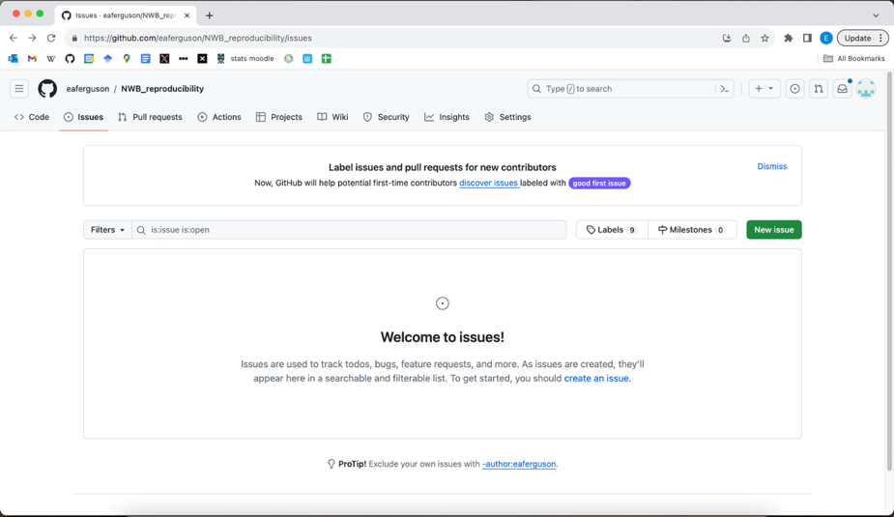
GitHub issues

Slide 28
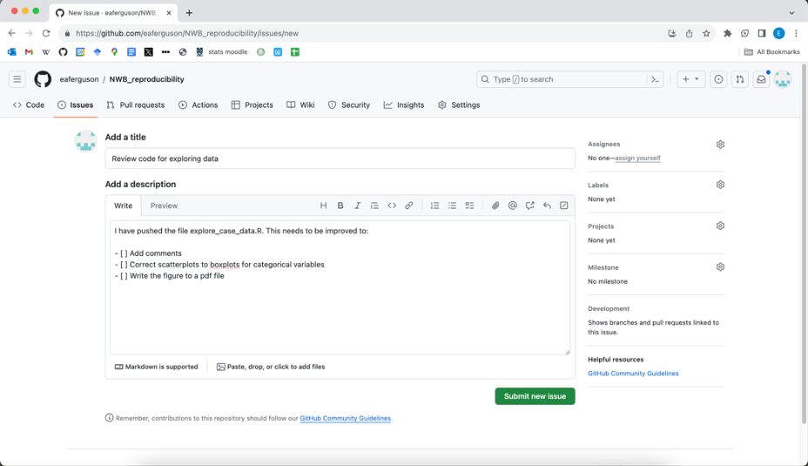
Creating an issue

Slide 29
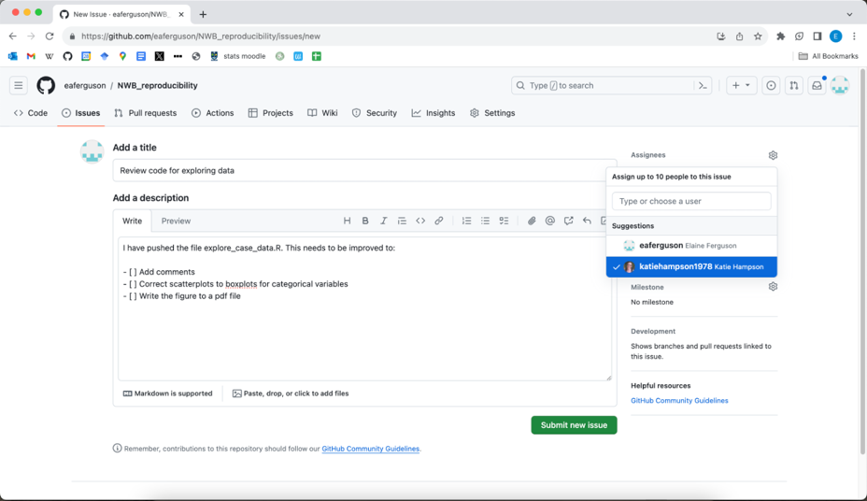
Creating an issue: Assigning

Slide 30
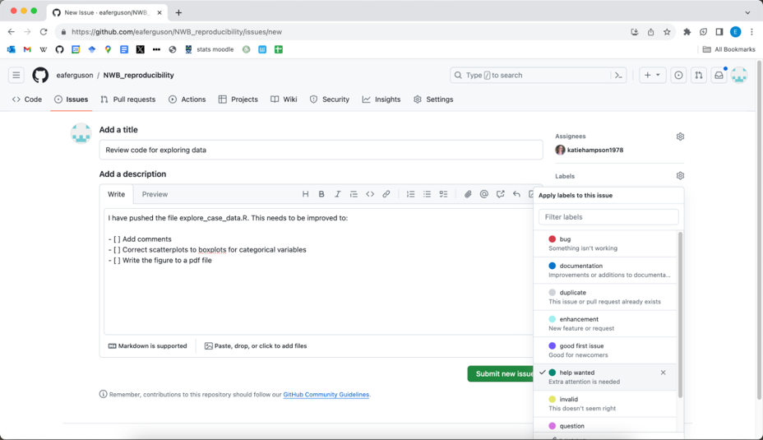
Creating an issue: Labels

Slide 31
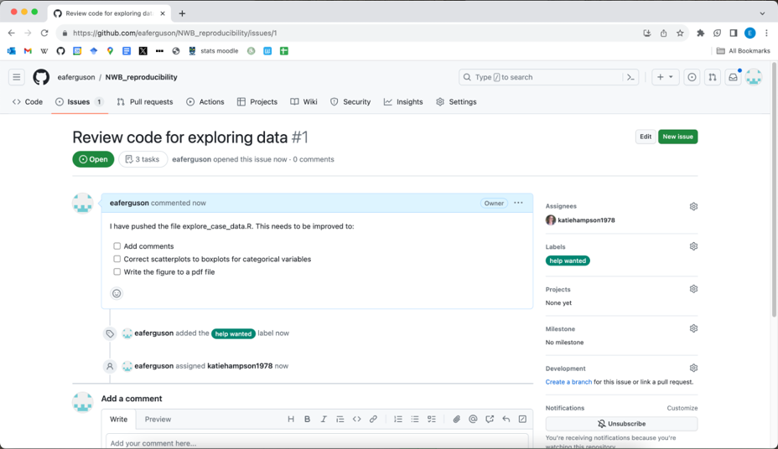
Creating an issue

Slide 32
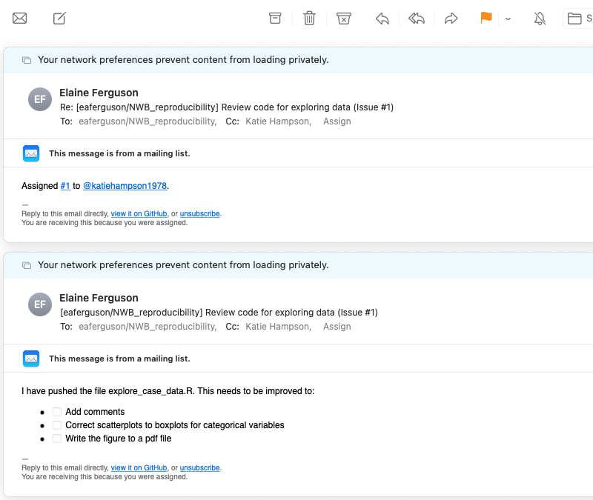
Collaborator receives issue notification

Slide 33
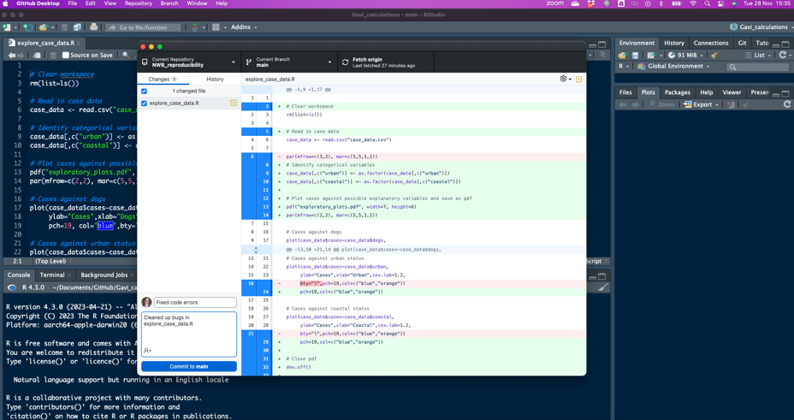
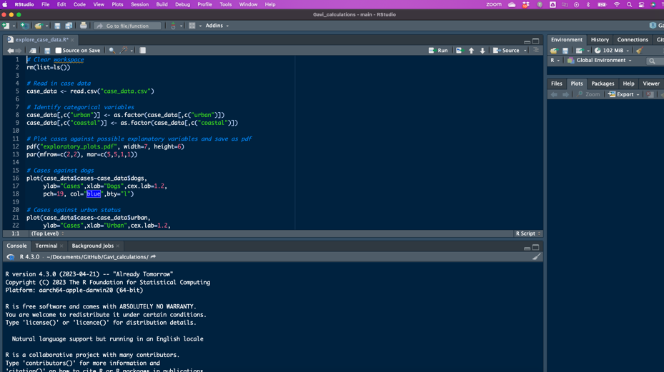
Collaborator corrects some errors in the code
& pushes correction back to repo

Slide 34
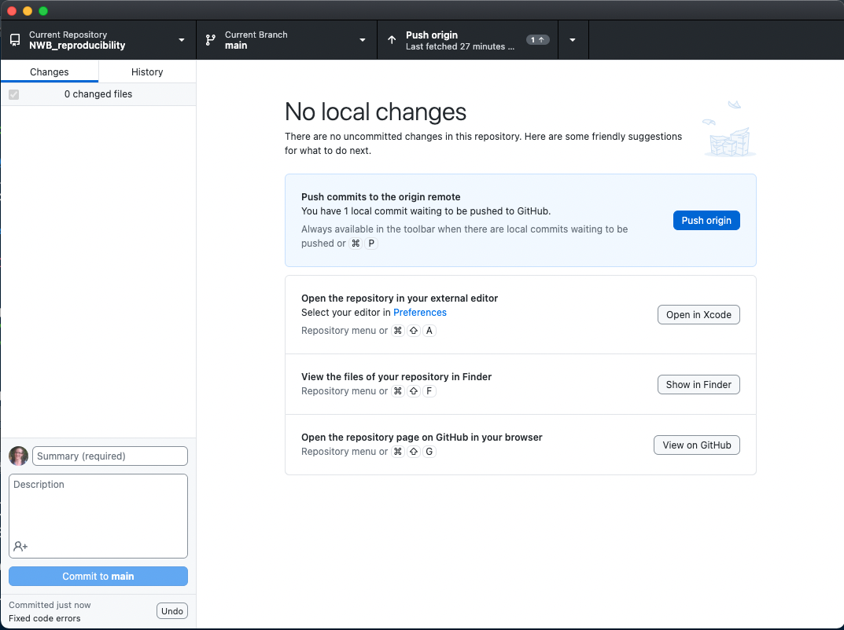
Collaborator corrects some errors in the code
& pushes correction back to repo

Slide 35
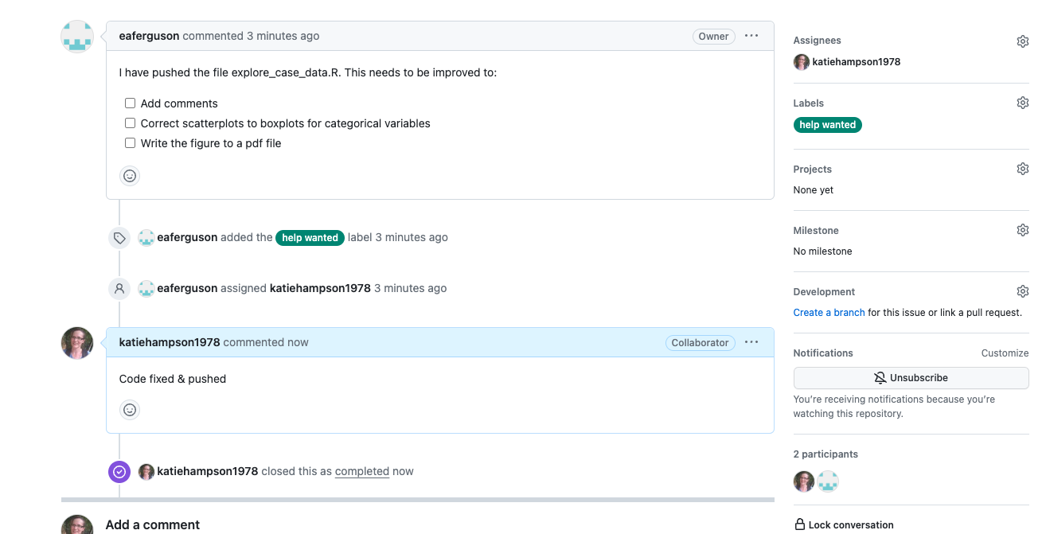
Collaborator closes the issue

Slide 36
Creating and resolving issues
Everyone create an issue for your repo and assign it – either to yourself or another group member (make sure everyone is assigned at least one).
Examples:
Update the README to provide more info about the repo
Fix a bug you noticed while trying to run the code
Change the plot colour
Create a rival plot in your favourite alternative software…
Work on fixing your assigned issue (trying not to work on the same file at the same time as someone else) and push the changes to GitHub
Mark your issue as resolved

Slide 37
Recovering lost files
Disaster strikes – someone has accidentally deleted the data file from your repo and everyone has already pulled the change.
How do we recover the file?

Slide 38
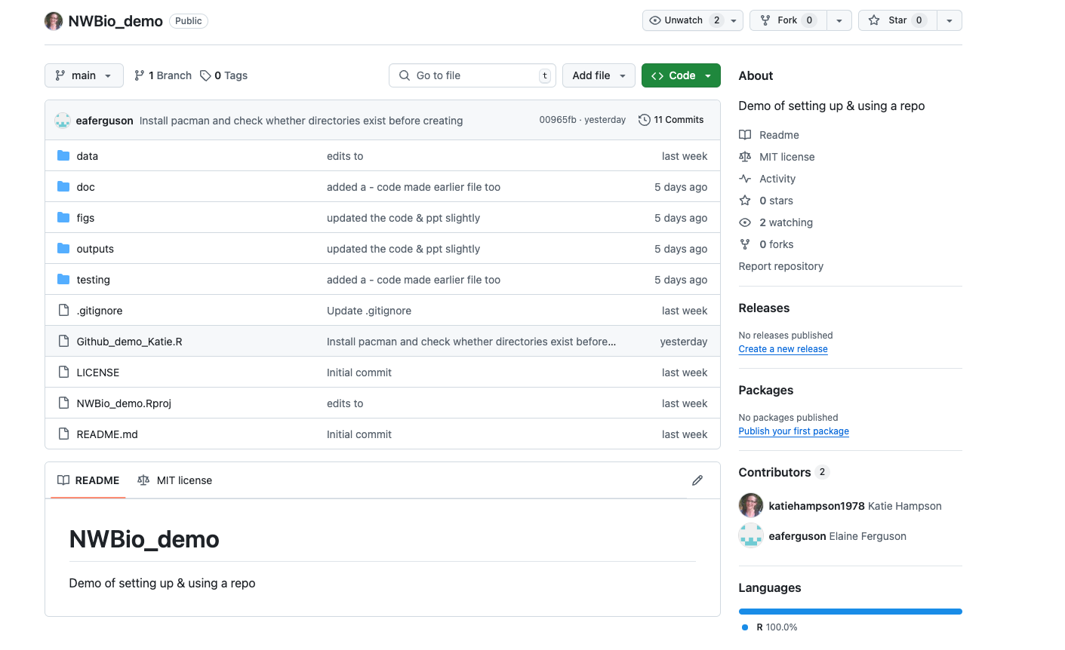
Recovering lost files
Go to your GitHub repo online, and look through the commits to find the one where the file was deleted

Slide 39
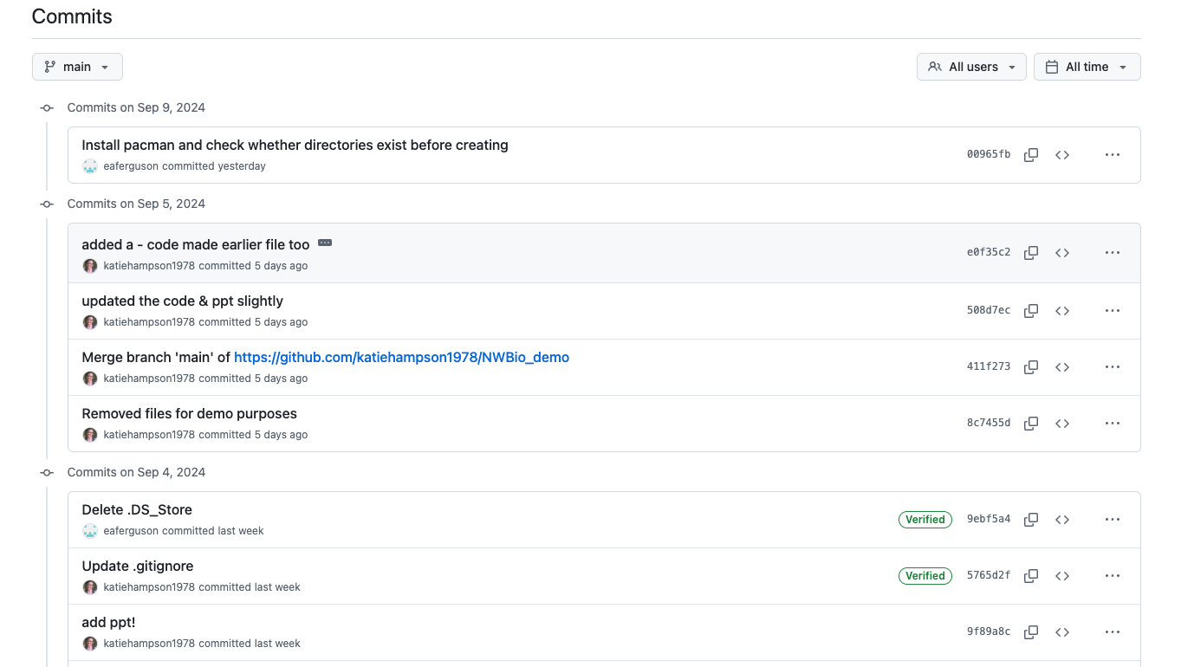
Recovering lost files
Go to your GitHub repo online, and look through the commits to find the one where the file was deleted

Slide 40
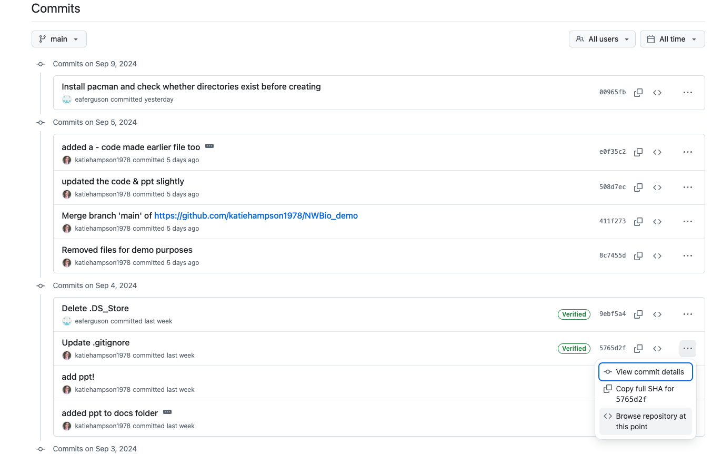
Recovering lost files
Go to the preceding commit and select “Browse repository at this point”

Slide 41
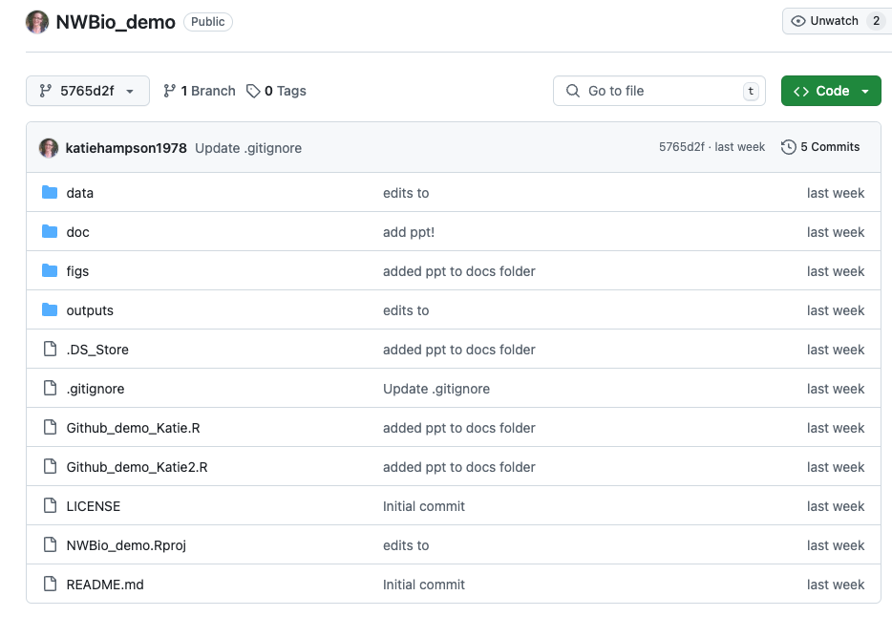
Recovering lost files
Locate and click on the deleted file in the old version of the repository

Slide 42
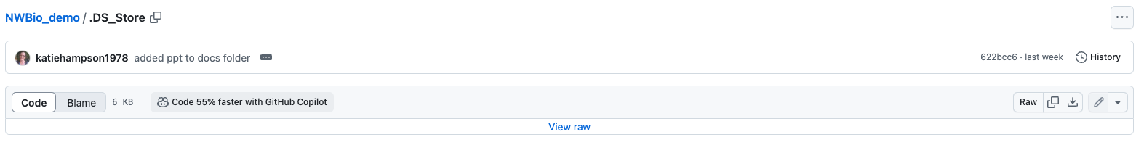
Recovering lost files
Download the deleted file:
Add the downloaded file back into your repo and push back to GitHub. Everyone can the pull the restored file.
In your groups, try deleting the data file from your repo and recovering it from GitHub.

Slide 43
Bonus R trick!

Slide 44
Did the venue preference barchart work?
6
4
university
n
Glasgow
Ifakara
2
0
Addis in Dar
Dumpling monkey
eSushi
Greggs
IHI cafe
Rose Garden
Sound Bites
venue
Is there anything you might need to edit when you present this work?

Slide 45
Did you know that svg files are editable!!!
6
4
university
n
Glasgow
Ifakara
2
ARGH?
0
Addis in Dar
Dumpling monkey
eSushi
Greggs
IHI cafe
Rose Garden
Sound Bites
venue
Glasgw

Slide 46
- Format shape
- Click and edit!
6
4
university
Glasgow
n
Glasgw
Ifakara
2
0
Dumpling monkey
eSushi
Greggs
IHI cafe
Sound Bites
venue
Addis in Dar
Rose Garden

Slide 47
6
4
university
n
Glasgow
Ifakara
2
0
Addis in
Dar
Dumpling
monkey
eSushi
Greggs
IHI cafe
Rose
Garden
Sound
Bites
venue

Slide 48
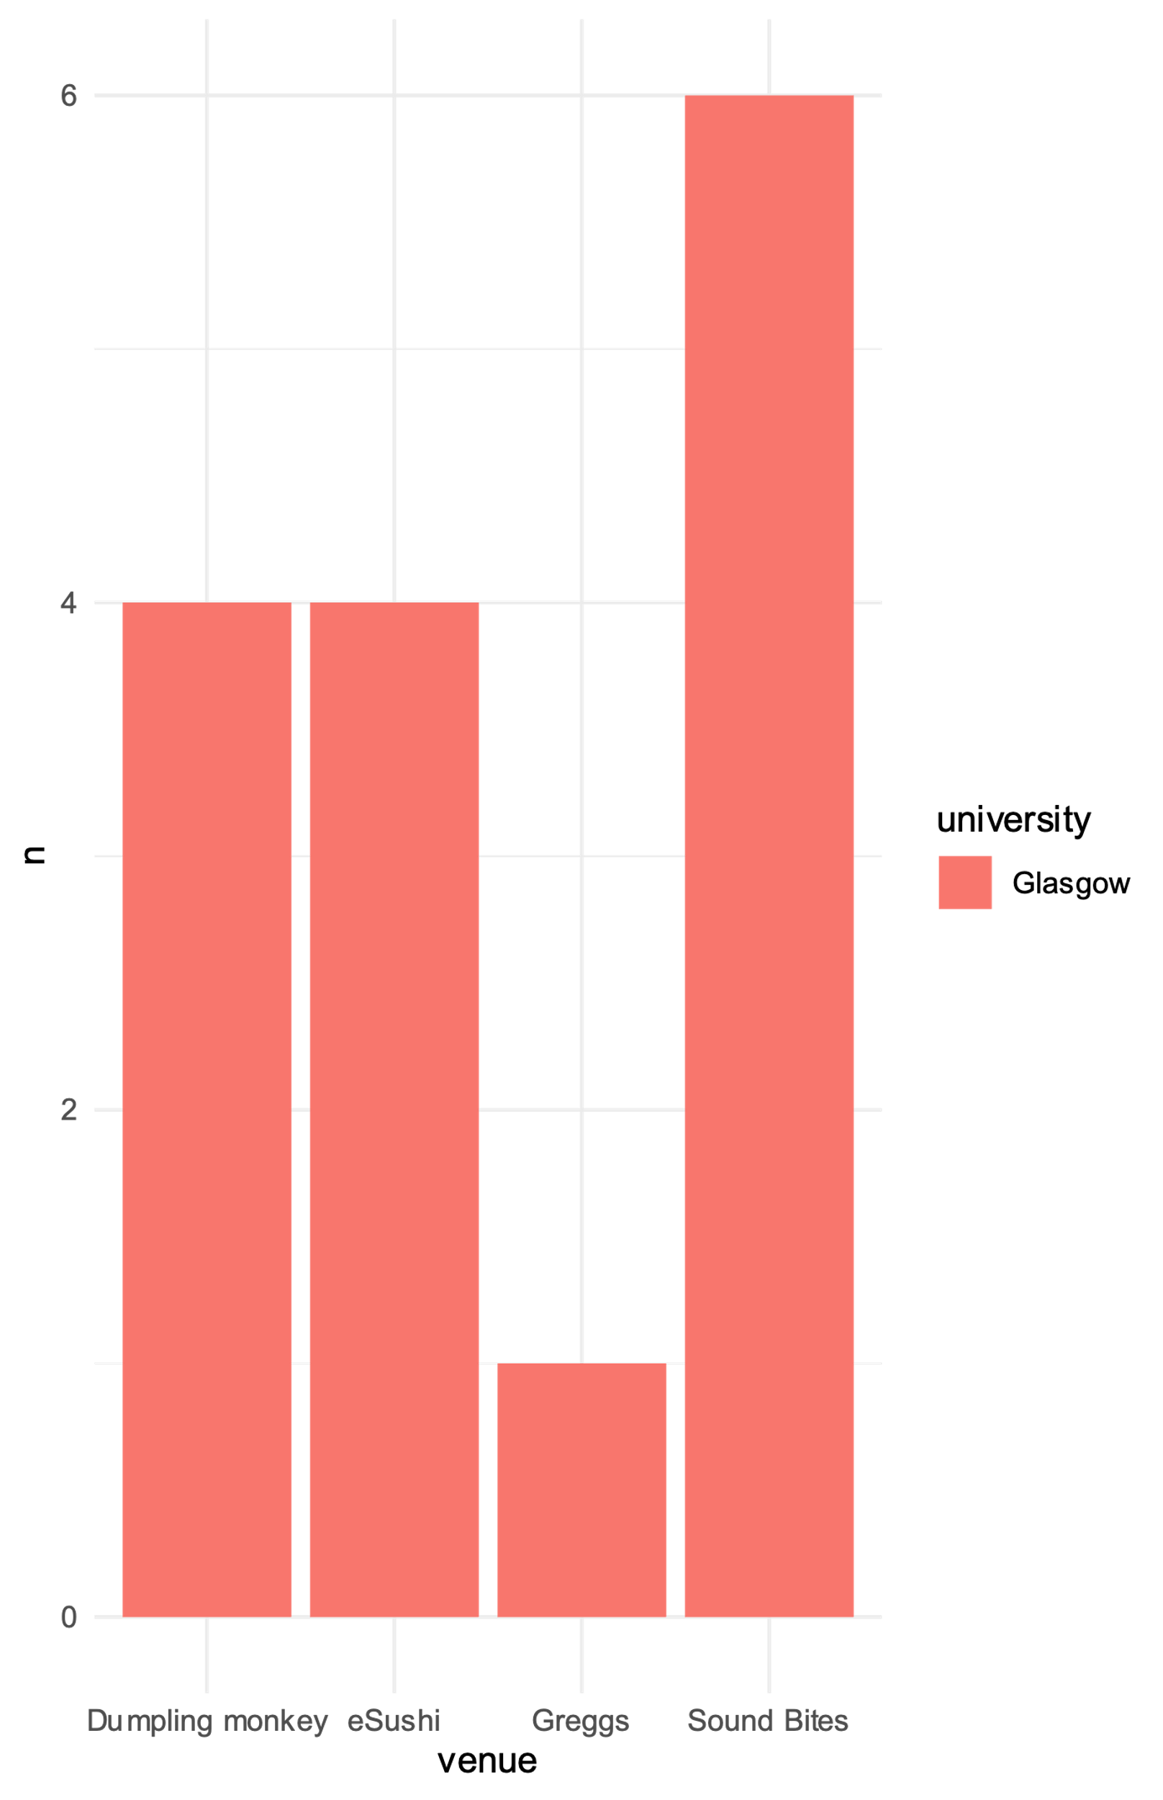

Slide 49
Github Learning:
How to navigate the Github website
Ideas about a sensible folder management structure
How to push/pull, commit/fetch in Github desktop
How to make, clone & join a Github repo
How to use issues
How to recover a lost file using version control
How to make a svg file in R that is editable
Notes:
TO DO
Find out the R experts & make sure they are present!
Make sure everything installed – Github desktop, R , Rstudio
Follow links that Elaine sent to connect (step 3 on desktop)
Make sure people open Github_demo.proj
Install packages too!

